Slide 1
ENCRYPTION WITH BITMAPS
Nicky Nocerino

Slide 2
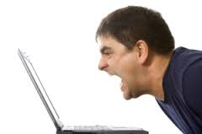
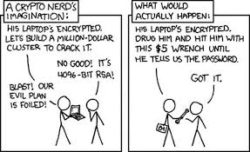
WHY?
Encryption is hard!!!
Encrypted data is secure, but easy to spot.

Slide 3

BITCRYPTION!

Slide 4

OVERVIEW
Length of message
3 part key
./bitcrypt.exe message.txt 100 12 63 9
./bitdecrypt.exe bitcrypted.bmp 100 12 63 9

Slide 5
LIVE DEMO!

Slide 6
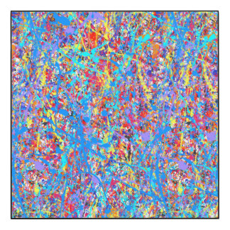
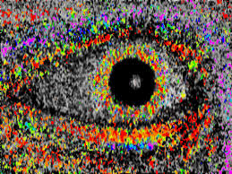

ADVANTAGES
Doesn’t look like encrypted data
Even if you know there is hidden data, its still difficult to crack
999^3 possible combinations of keys
Easy to make, you can make your own!

Slide 7
DISADVANTAGES
A LOT of junk data
Not as strong as other encryption methods
The more data you have
the worse your cover picture looks
The longer it takes
Only works up through the extended Ascii table
Can never be popular

Slide 8
POSSIBLE FUTURE IMPROVEMENTS
Adjustable bitmap sizes
Help reduce amount of junk data
Include another level of encryption
Increase security if discovered
Improve algorithms for data allocation
Allow for longer or more complicated keys
Expand to other image formats

